Slide 1
Analysis on Departures for Foreign Employment with Real Wages and Paddy Harvest
CS5617
Group 3

Slide 2

GROUP 03
T. I. Hemakumara
199326J
K.Ignatius
199330P
K.A.U.Sewwandi
199363T
W.V.R.D.Wasana
199370L

Slide 3
INTRODUCTION
Paddy is the foremost crop in Sri Lanka
Drastic drop in paddy harvest due to
changes in monsoon, droughts & flooding
irrigation problems
pest control issues - Sena caterpillar
Farmers/family members may migrate as temporary migrants in order to earn for living & improve quality of life
Notes:
Paddy is the foremost crop in Sri Lanka from ancient times. The history, economy and culture of the country has a tight relationship with paddy cultivation. Still half of the population consisting a lot of unskilled people and people who inherits paddy fields engage in paddy cultivation.
There are two seasons namely Yala season from May to August and Maha season from September to March to cultivate paddy.
This tradition was established considering the two monsoons occur in the country to properly get water required. But due to adverse effects, the climate has changed and the time that monsoons occur has changed affecting the paddy cultivation. Also issues like irrigation problems and pest control issues have contributed.
After spending a huge amount of money and ending up with poor harvest and less market opportunities, farmers lose their capital and many of them go through several hardships to repay their debts obtained from government and private institutes or from other sources.
Most of the labourers engaged with cultivation are unskilled workers and solely depend on paddy cultivation and they become unemployed work due to lost of harvest. The aggregation of these reasons creates or increases poverty, starvation and depression among farmers and among their families.
Let us take a look at some important statistics of rice cultivation presented by the Department of Agriculture in Sri Lanka:
• Rice occupies 34% of total cultivation in Sri Lanka.
• Approximately 1.8 million families island - wide are engaged in paddy cultivation.
• Current production of rice is about 2.5 million tons annually to satisfy 95% of the domestic requirement.
• For an average Sri Lankan, rice provides 45% total calorie intake and 40% total protein requirement.
• The per capita consumption of rice ranges at about 100kg per year.
• The annual demand for rice is expected to grow at 1.1%
• Annual production should grow at 2.9% to meet this demand.
• Sri Lanka’s current cost of production for rice is LKR 8.57 per kg, with labor occupying 55% of this cost.
In recent years viability of the paddy production sector in Sri lanaka has been a question because of lack of net profit to the paddy-producing farmers.
Even though the country could able to reach the self-sufficiency due to increased average yield and extent of cultivation it failed to satisfy the poor farmers.[2]

Slide 4
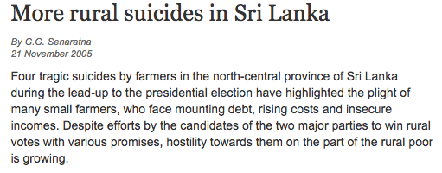
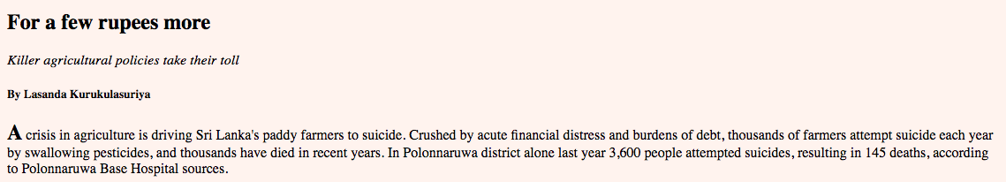
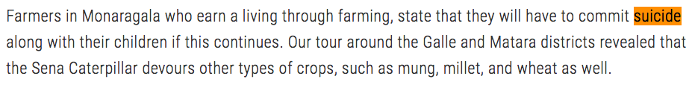
Crisis in agriculture driving Sri Lanka’s paddy farmers to suicide.
Notes:
During the last decade there were several tragic suicides by small farmers in north-central province of Sri Lanka who were crushed by mounting debt, sky high rising of prices of commodities and insecure income has been reported [3]. The civil war which lasted for several decades and the natural hazards like droughts, floods and storms were few of the key causes for these tragedies [4].

Slide 5
PROBLEM STATEMENT
Find linear correlation between departures of unskilled labourers for foreign employment with average real wages in informal sector and average paddy harvest
Notes:
There are several reasons for a person to leave the native land. Political instability, economic condition, infrastructure facilities given by the government and development of the country are some factors that a person would consider before leaving the country for employment purposes. Condition of living and financial status are the most important factors among them. When considering the factors mentioned above with respect to the issues in paddy cultivation and harvest, this would lead these unskilled farmers and their families to leave the country for foreign employment. In order to find the correlation between total annual paddy harvest and departures of unskilled workers for foreign employment we carried out a hypothesis testing based on correlation. During the analysis we identified that the hurdles to earn money is the main reason for annual paddy harvest may have a correlation with departures for foreign employment. Therefore we carried-out another hypothesis testing to find the correlation between real average wages of unskilled workers under agriculture sector and departures for foreign employment. The problem trying to address in this research is to find if there’s a linear correlation between total annual paddy harvest and departures of unskilled workers for foreign employment and further find if there’s a linear correlation between real average wages of unskilled workers and departures of unskilled workers for foreign employment. It would be useful for authorities and social workers who can provide support to uplift the lives of farmers.

Slide 6

METHODOLOGY
Data preprocessing
Statistical analysis on the dataset
Hypothesis testing using pearson correlation coefficient
Notes:
Our Methodology consisted of three steps:
Data Preprocessing
Statistical Analysis
Hypothesis Testing
In order to solve the problem of finding if there’s a negative linear correlation between total annual paddy harvest and departures of unskilled workers for foreign employment and further finding if there’s a negative linear correlation between real average wages of unskilled workers of agriculture sector and departures of unskilled workers for foreign employment, Pearson correlation was considered.

Slide 7

DATASETS USED
Paddy production in Yala & Maha seasons 1994-2017
Departures for foreign employment 1994-2017
Average daily wages in informal sector 2006-2017
Notes:
OPENDATA portal of Sri Lanka
Basically data relevant to Sri Lanka was considered over the past two decades. Four datasets used were as follows. 1) Paddy production in Yala season [5] 2) Paddy production in Maha season [6] 3) Departures for foreign employment [7] 4) Average daily wages in informal sector [8]

Slide 8

DATA PREPROCESSING
Numerical missing values replacement with average values
Data integration from different sources
Data normalization and aggregation
Notes:
The data preprocessing was carried out in three steps.
The missing values in departures for employment dataset [7] was replaced with average of the particular attribute.
Then data integration was performed by integrating data of several sources to create the required dataset.
Data transformation is the accumulation of data normalization and data aggregation.
We have used proportion transformation to proceed with the analysis [12].
The departures for foreign employment dataset only contains data from year 1994 to year 2012. So we found latest data related to departures for foreign employment from year 2013 to year 2017 from a statistical report of Sri Lanka Bureau of Foreign employment [9].
The dataset for paddy production in Yala and Maha seasons contains data from year 1952 to year 2012.
But in order to perform the hypothesis testing got a sample from year 1994 to 2012 and from external sources published by the Sri Lankan government found recent data from year 2013 to year 2017 [10].
The average daily wages dataset only contains data from year 2006 to year 2012.
The latest data from year 2013 to year 2017 were also found from external sources like statistical reports from Central Bank of Sri Lanka.
The average daily wages mentioned in the wages dataset are nominal wages. They are not indicative of the purchasing power of labourers of the informal sector. Therefore real wage values were calculated using wages dataset and the annual inflation rates of Sri Lanka provided by the International Monetary Fund (IMF) publications.

Slide 9
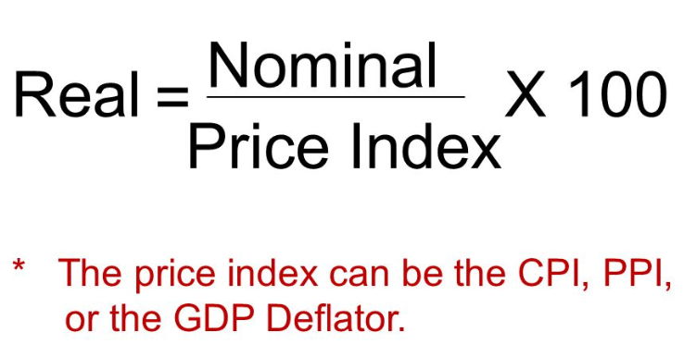
CALCULATION OF REAL WAGES
Notes:
To compare the purchasing power of wages from year to year, wages need to be adjusted by taking inflation into account. Real wages can be calculated using the Consumer Price Index (CPI).
The real wages were calculated by dividing the nominal wage of the year from the Consumer Price Index (CPI) value of the year and multiplying it by 100
Consumer Price Index (CPI) values were calculated using Consumer Price Index (CPI) of the previous year multiplied by (100% + annual inflation rate of the current year ) [11].
===== STOP and TRANSFER =====

Slide 10
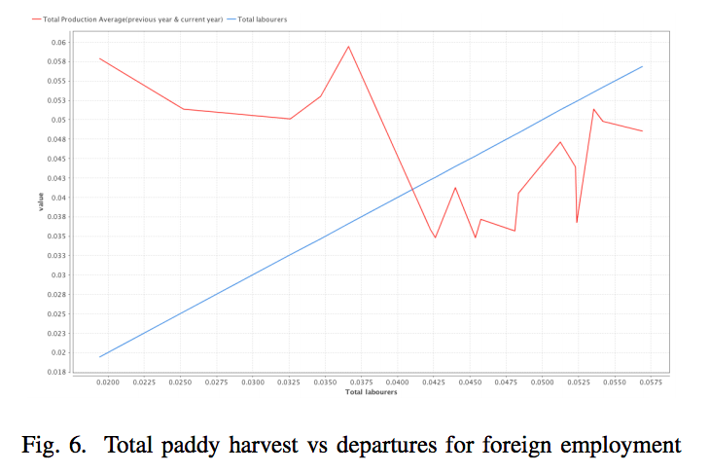
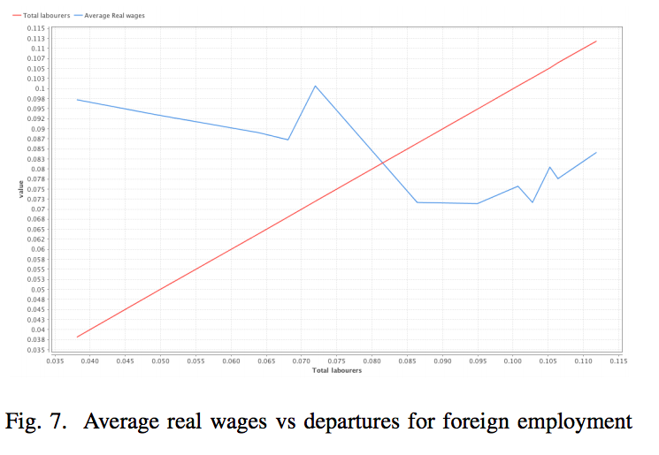
Notes:
Proportion transformation is a normalization which is based on the proportion each Attribute value has on the complete Attribute(each value is divided by the total sum of that Attribute values). The total is calculated only from finite values, neglecting missing values and also positive and negative infinity. Since the ranges of numerical attributes in the datasets varied from thousands to metric tons normalization was done using proportion transformation which brought ranges of all attributes to 0 and 1

Slide 11
HYPOTHESIS TESTING
Scenario 1
Hypothesis
H0 : Correlation coefficient (ρ) between departure of the unskilled workers for the foreign employment and the average paddy production = 0
H1: Correlation coefficient (ρ) between departure of the unskilled workers for the foreign employment and the average paddy production <> 0
Sample size : 24 samples from year 1994 to year 2017
Notes:
The population for scenario 1 is all the annual departures of unskilled workers for foreign employment and all the annual paddy harvest in Yala and Maha seasons in the past. A sample of 24 was taken for analysis from year 1994 to 2017.

Slide 12
HYPOTHESIS TESTING contd...
Scenario 2
Hypothesis
H0 : Correlation coefficient(ρ) between departure of the unskilled workers for foreign Employment and average real wages of informal sector = 0
H1 : Correlation coefficient(ρ) between departure of the unskilled workers for foreign Employment and average real wages of informal sector <> 0
Sample size : 12 samples from year 2006 to 2017
Notes:
The population for scenario 2 is all the annual departures of unskilled workers for foreign employment and all the annual average real wages for unskilled workers in the past. A sample of 12 was taken for analysis from year 2006 to 2017.

Slide 13
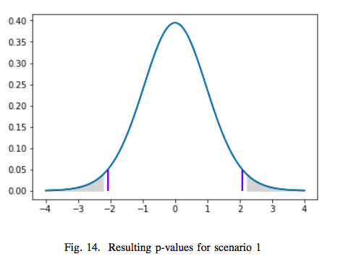
RESULTS
Scenario 1
Confidence level - 95%
Level of significance(α) - 0.05
Degree of freedom - 23
P-value - 0.05
P-value = α
Reject null hypothesis -> There exist a correlation between average paddy harvest and departures of unskilled labourers for foreign employment
Notes:
Test statistic - 2.166
Hypothesis test was carried out as mentioned earlier using t distribution and 95 % confidence level. The degree of freedom is 23 here which is one less than the sample size(24).

Slide 14
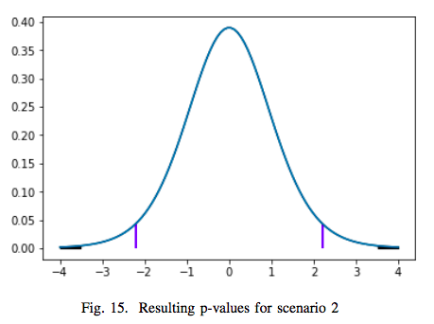
RESULTS contd….
Scenario 2
Confidence level - 95%
Level of significance(α) - 0.05
Degree of freedom - 11
P-value - 0.005
P-value < α
Reject null hypothesis -> There exist a strong correlation between average real wages and departures of unskilled labourers for foreign employment
Notes:
Test statistic - 3.495
Hypothesis test was carried out as mentioned earlier using t distribution and 95 % confidence level. The degree of freedom is 11 here which is one less than the sample size(12).

Slide 15
Conclusion
There is a negative correlation between total annual paddy harvest and departures of unskilled workers for foreign employment.
There is also a negative correlation among average real wages in informal sector and departures of unskilled workers for foreign employment.

Slide 16

THANK YOU !
Q & A

